Slide 1
WELCOME TO KS1
Notes:
CP

Slide 2
KS1 Teachers
Scotland Road Campus
Mrs Patricia Downer (Badgers)
Miss Hannah Cousins (Foxes)
Miss Tayla Mundy-Gill (Hares)
Miss Charlotte Martell (KS1 Academic Mentor)
Kersall Drive Campus
Mrs Charlie Precious (Rabbits)- KS1 Leader
Mrs Georgi Wiser (Rabbits)
Mrs Lucy Fisher (Hedgehogs)
Miss Molly Wilkins (Owls)
Mrs Suzanne Comber (Squirrels)
Mrs Kieran Lalli (KS1 Academic Mentor)
Notes:
CP

Slide 3
KS1 Additional Adults
Kersall Drive Campus
Mrs Tracey Askew
Mrs Diane Fitch
Miss Jess Mackay
Miss Charlotte Mead
Miss Mel Reast
Mrs Jeanette Young
Scotland Road Campus
Miss Anita Malone
Mrs Gill Allen
Mrs Lucinda Hayes
Mrs Fil Pagnozzi
Notes:
CP

Slide 4
Communication
We intend to have open and clear communication with Parents/Carers.
Non urgent
Email class email
Speak to teacher at the beginning or end of the day
Urgent
Ring office
Please make sure phone numbers are up to date!

Slide 5
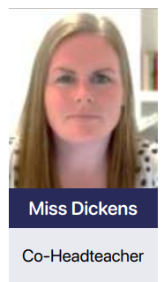
Safeguarding Team

Slide 6
Notes:
MW

Slide 7
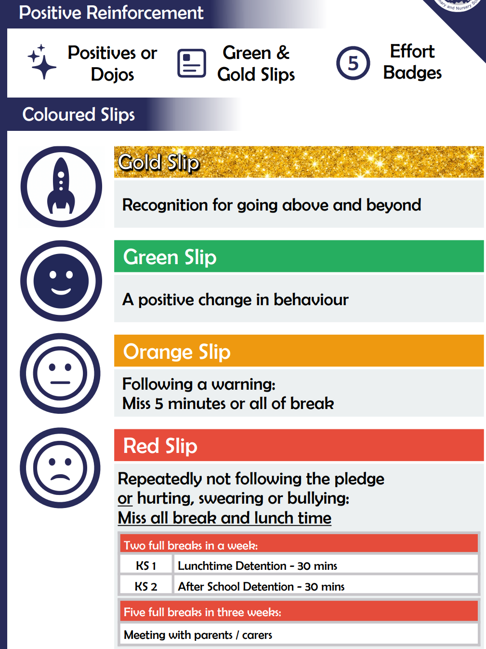

Slide 8
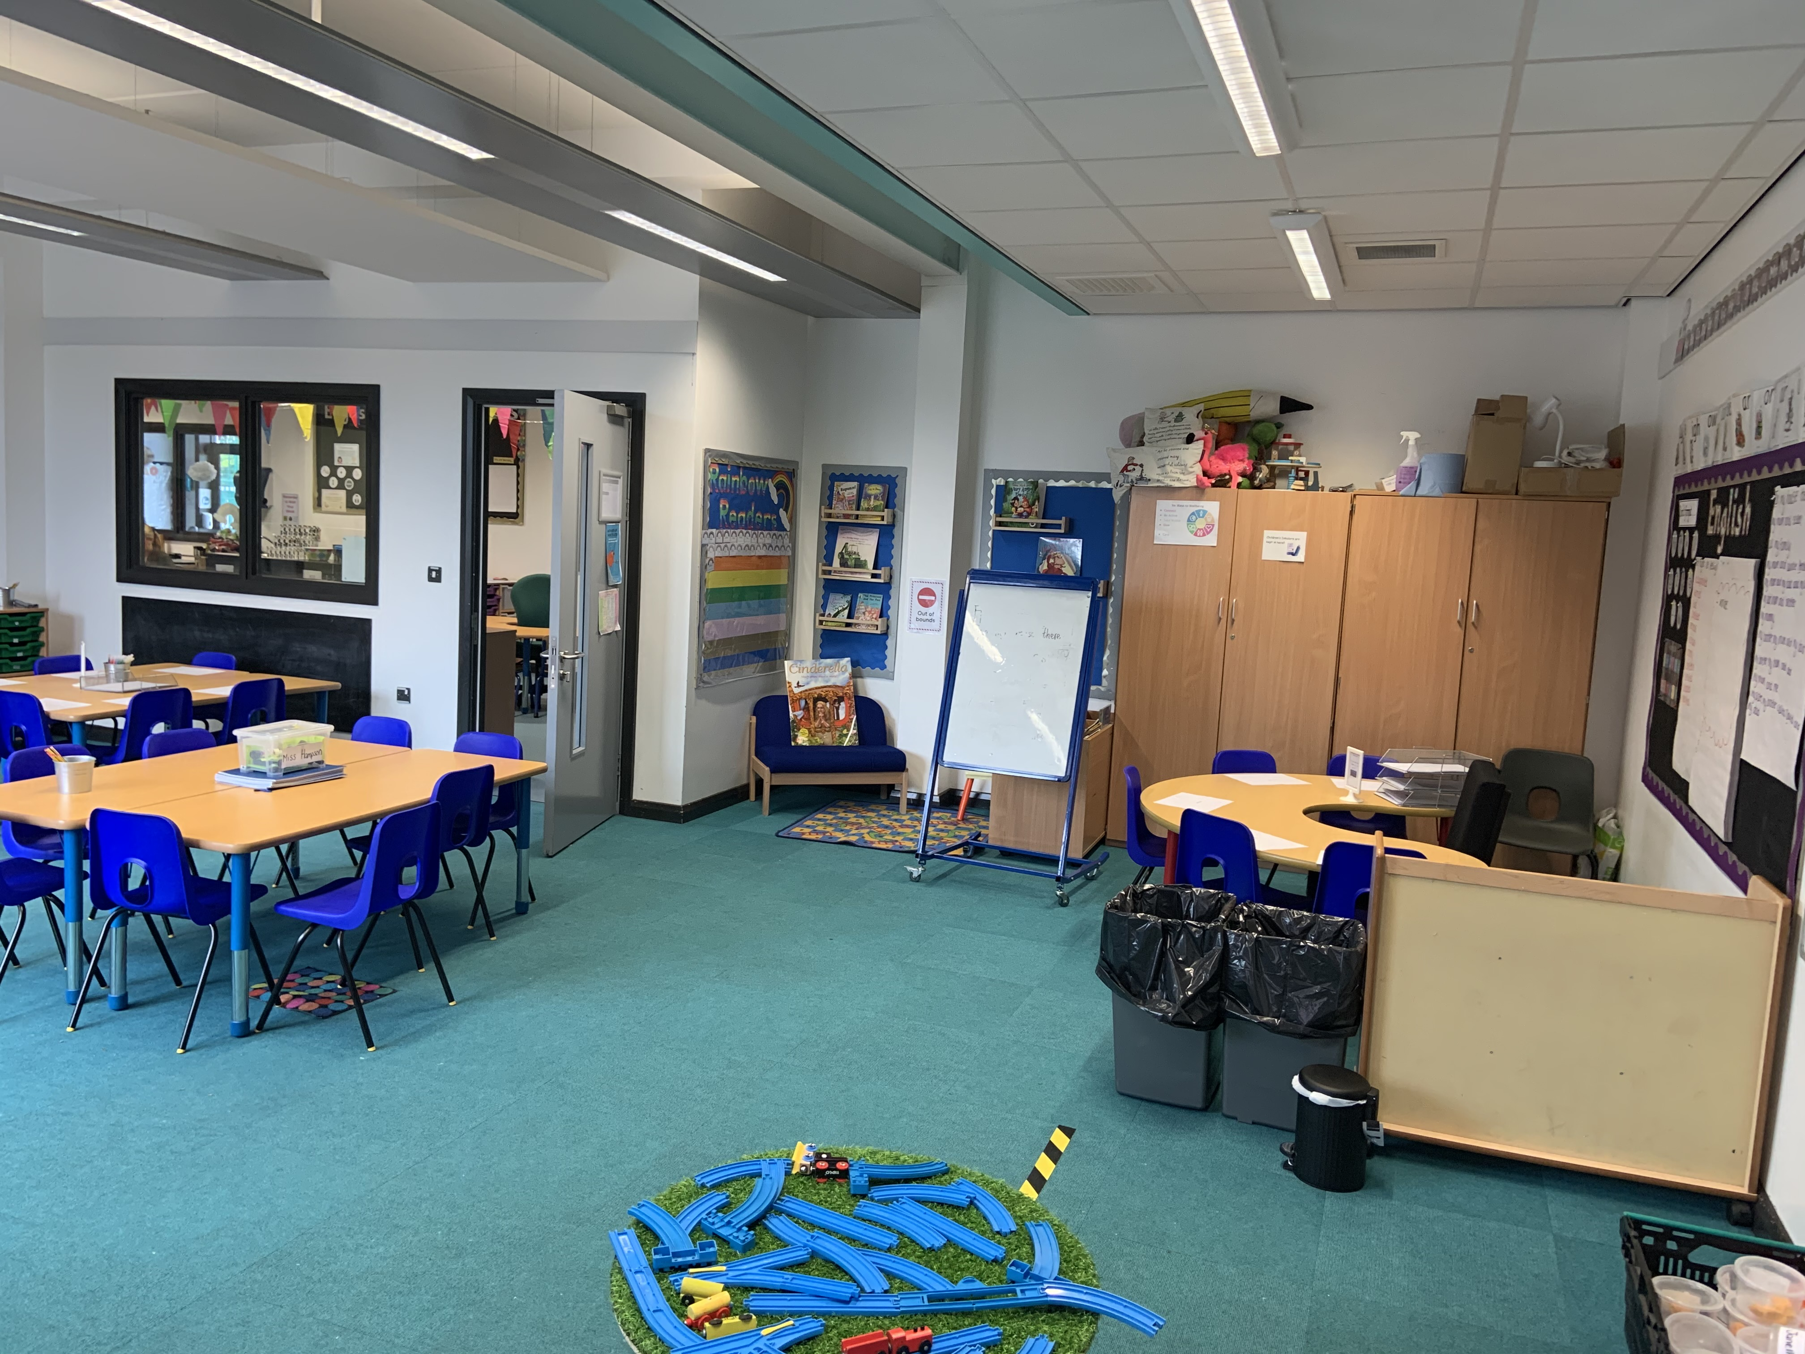
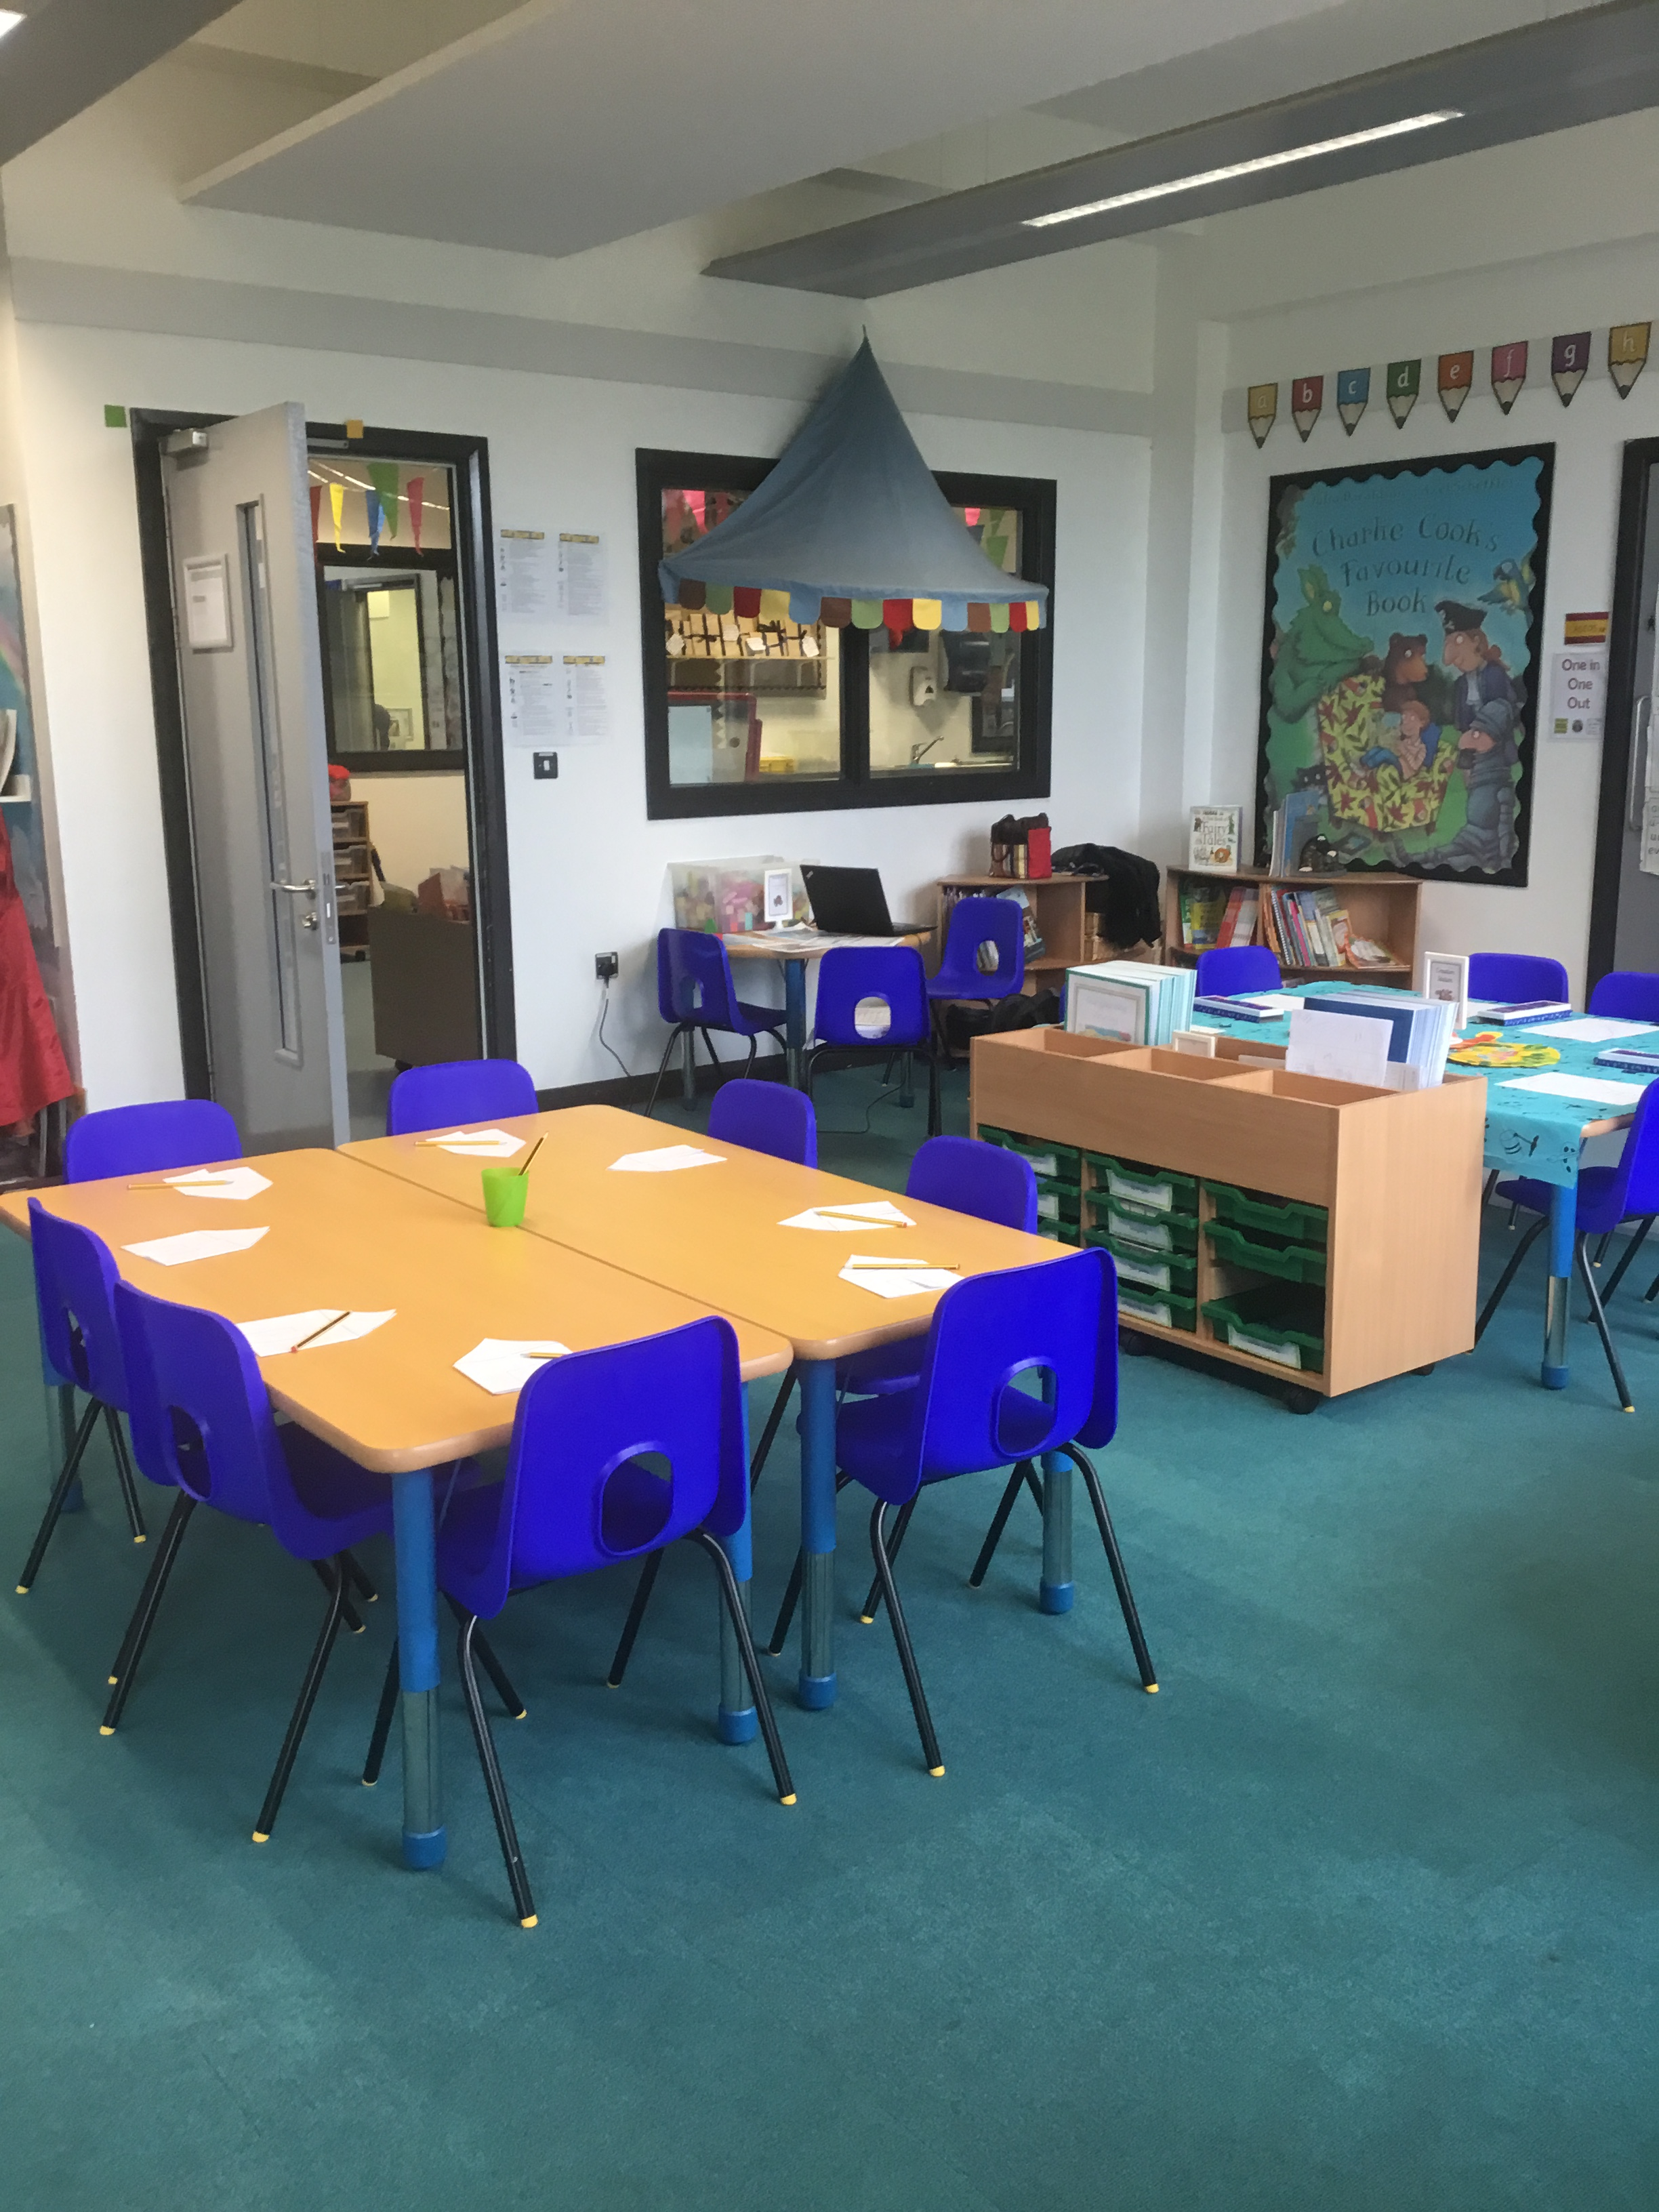
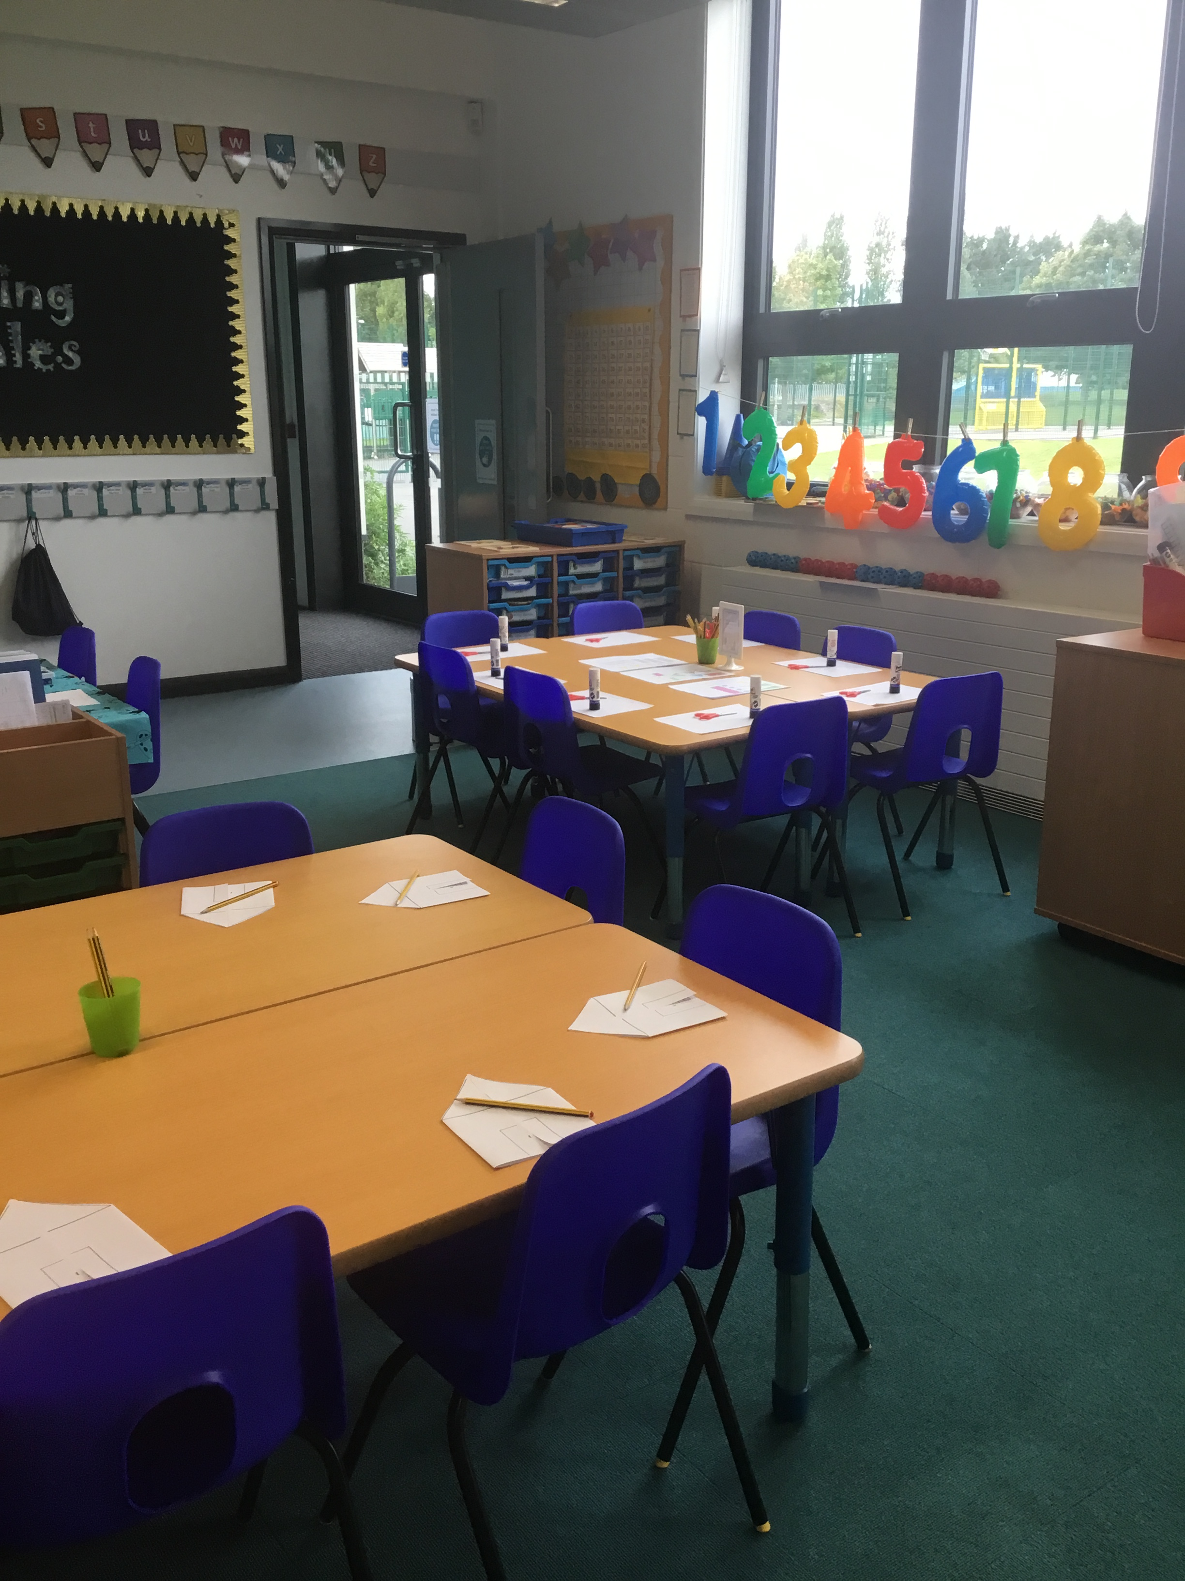
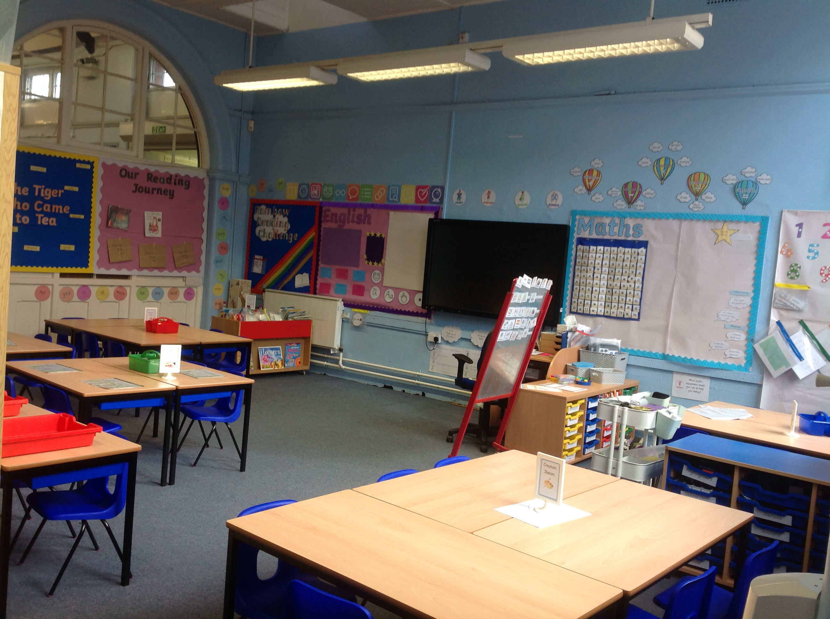
Our Learning Environments
Notes:
CP

Slide 9
A Typical Day In KS1
8:45-8:55 | 9:00-9:45 | 9:45-950 | 9:50-10:30 | 10:30-10:45 | 10:45-11:45 | 11:45-12:45 | 12:45-1:15 | 1:15-1:20 | 1:20-2:20 | 2:15-2:30 | 2:30-2:50 | 2:50-3:10 | 3:15
REGISTRATION MORNING ACTIVITY | Phonics | GROSS MOTOR ACTIVITY | Maths | BREAK TIME MILK and SNACK | English | LUNCH | Reading | GROSS MOTOR ACTIVITY | Science Topic PE PSHE RE | BREAK TIME | Handwriting | ASSEMBLY | HOMETIME
Notes:
CP

Slide 10
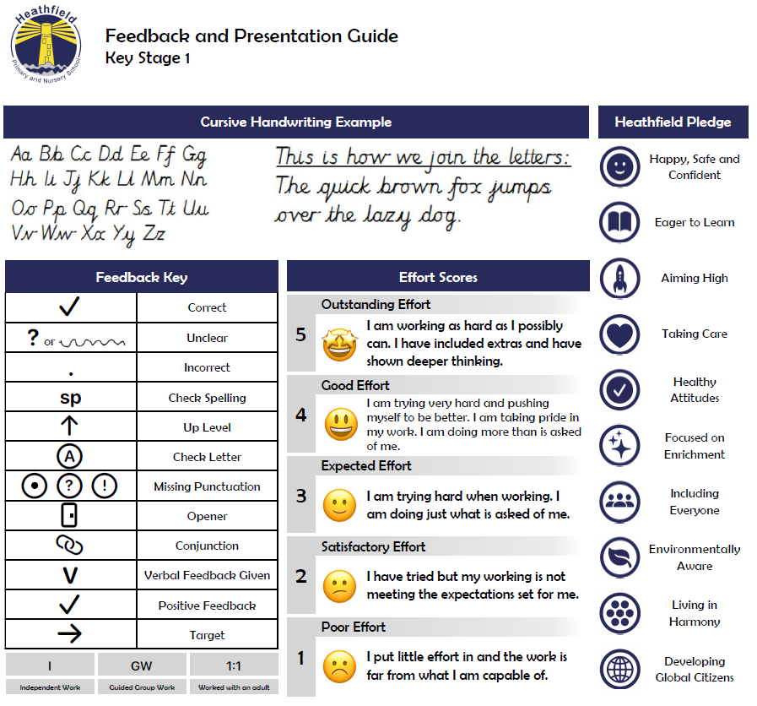
Notes:
MW

Slide 11
Curriculum
Autumn 1 | Autumn 2 | Spring 1 | Spring 2 | Summer 1 | Summer 2
Transport | Toy Story | Woodland Animals | Roald Dahl | Dinosaurs | Minibeasts
Main Focus: History and Art | Main Focus: History and DT | Main Focus: Geography and Art | Main Focus: History and DT | Main Focus: Geography and DT | Main Focus: Geography and Art
Notes:
MW

Slide 12
Trips and Enrichment
Autumn 1​ | Autumn 2​ | Spring 1​ | Spring 2​ | Summer 1​ | Summer 2​ ​
Transport | Toy Story | Woodland Animals | Roald Dahl | Dinosaurs | Minibeasts
Hook: Grand Prix 12/9/23 | Hook: Toy Day | Hook: Owl Man | Hook: Potion Making | Hook: CCTV Dinosaur Discovery Day | Hook: Bug Ball
Trip: To be confirmed | Visitor: Toy Workshop | Trip: Year 1 Late Night (school) Year 2 Residential to Walesby | Visitor: | ​Visitor: | Theme Day: Caribbean Carnival Trip: ​ Year 2 Residential​ to Seaside (Whitby)
Events:​ Welcome Meeting 5/5/23 Open Afternoon 11/10/23 | Events- Parents Evening RSC Week Remembrance Day Anti-bullying Week Children in Need Stars in our School KS1 Winter Show​ Christmas Dinner Christmas Party Christmas Jumper Day | Events-​ Book Week ​World Religion Day | Events-​ Fairtrade Fortnight World Book Day British Science Week Red Nose Day Easter Bonnet Parade | Events-​ Book Week RSC Day Year 2 SATs​ | Events-​ Year 1 and 2 Phonics Screening​ Sports Day​ Annual Reports Change Around Day
All trips and events are subject to change. Dates will be shared via topic overviews, Newsletters and Text Messages
Notes:
MW

Slide 13
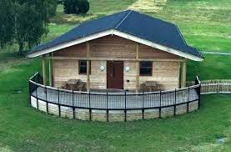
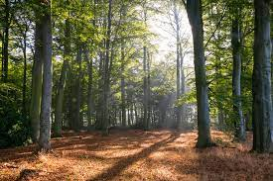
Year 2 Residential to Walesby
Year 2 children will have the fantastic opportunity to visit Walesby in February 2024.
Children are invited to go on a 1 night, 2 day trip to log cabins in the Sherwood Forest area where they will explore the local woodlands and take part in a range of exciting activities.
A form on interest was sent before the Summer but this did not guarantee a place so please look out for the official sign up sheet which will be out in the next couple of weeks.
Notes:
CP

Slide 14
Notes:
LF

Slide 15
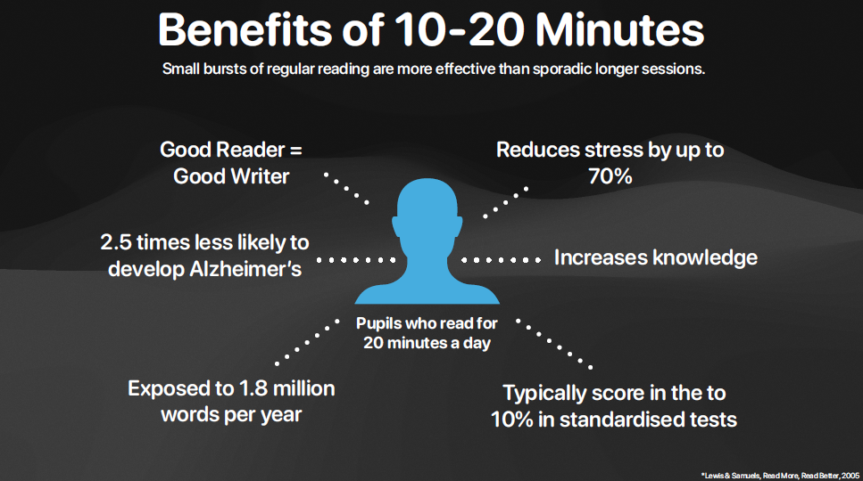
Notes:
LF

Slide 16
Reading
Speed Sounds
Book Bag Book
Phonics Books
Reading Book
Read, Write Inc
Rainbow Reading
Reading for pleasure
Class Stories
Key Texts
Library Books
Trolley Books
Topic Books
Notes:
CP

Slide 18
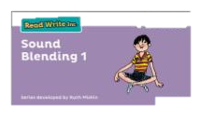
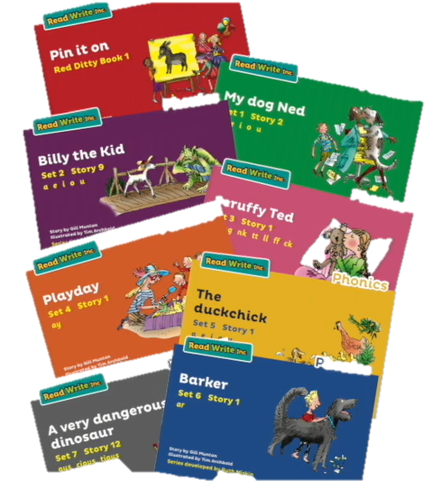
Read, Write Inc
Ruth Miskin Training
Phonics Book
(colour currently on)
2. Recap Book
(previous colour on)
3. Reading for pleasure
book
Notes:
LF

Slide 19
Rainbow Reading Challenge Your child needs to be reading EVERYDAY!
Rainbow Coloured Challenge Cards will be sent home with your child alongside a reading book each week.
Rainbow reading cards need to be signed by an adult AT LEAST 3 times in a week.
Prizes will be given for completion of different cards.
Children MUST bring their book bags with their reading book and reading card every day as they could be chosen to read with an adult at school at any time!
Notes:
LF

Slide 20
Homework
Each child will each receive a homework book that must be kept in their book bags and bought to school every Friday.
At the beginning of every half term a ‘Topic Overview’ will be shared in children’s homework books. It will share details of the different things we will be doing throughout our topic such as key texts, outdoor learning and enrichment so you can support and discuss learning with your child at home. They will also receive a ‘Creative Homework’ sheet which will contain a range of activities related to our topic for the children to have a go at each week.
Notes:
KP

Slide 21
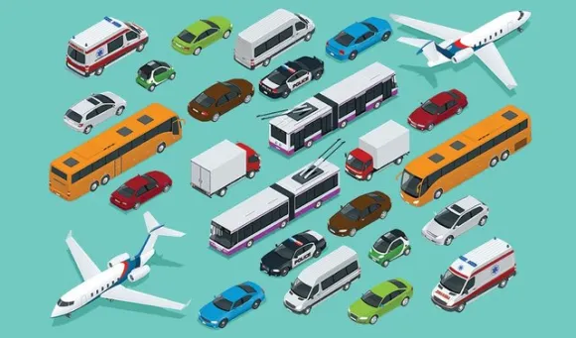
The Hook
Transport
Enrichment
We will be celebrating all things that move during our KS1 Grand Prix!
Children will have to opportunity to bring an item with wheels e.g. bike, scooter, roller-skates to travel around our assault course.
We will be going on different forms of transport like a tram and a bus and seeing other transport in actions like a motorbike, car and others. Keep an eye out for the date on our weekly school newsletters.
The Aim
This half term we are learning all about the different types of transport and how it helps us get around. In particular we will be focussing on flight travel.
Learning Outside the Classroom
Pupil Voice
“How do planes stay in the sky?"
How long does it take to get to space?”
“Can we live in space?”
“Are aliens real?”
“What vehicle is the fastest?”
We will be spending lots of time outside this half term while the weather is still nice doing science experiments to find out more about different types of movement.
Our Key Texts
The Big Book of Transport
By
Moira Butterfield
Man on the Moon
By
Simon Bartram
Rocket says Look Up!
By
Nathan Byron
Parental Engagement
SMSC/British Values
We would like to invite parents to a 'Welcome Meeting' on 5/9/23 to hear all about KS1. We will also be opening our classrooms for you to see what we have been up to on 11/10/23.
Through the process of learning our school and class rules we will enable students to distinguish right from wrong and to respect the civil and criminal law of England too.

Slide 22
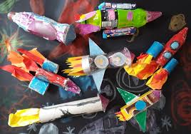
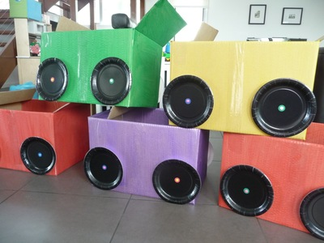
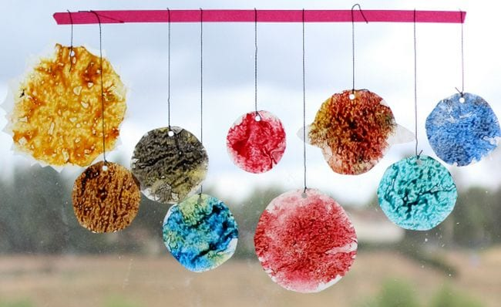
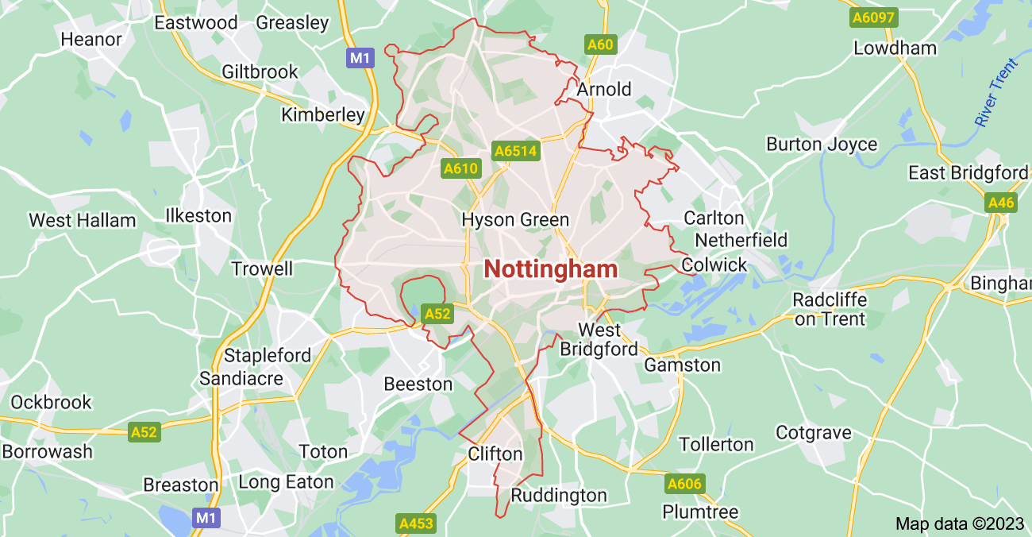
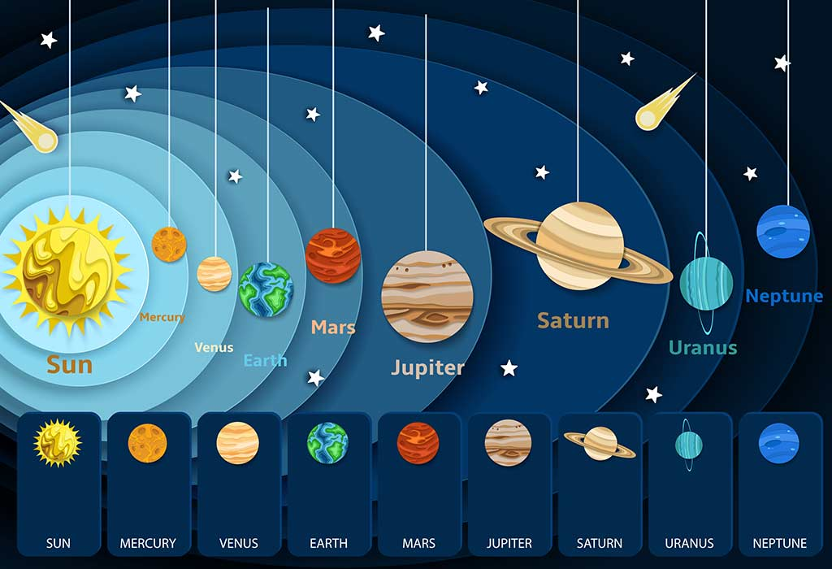
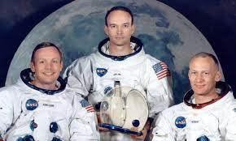
For our topic ‘Transport’ we have designed a selection of homework activities for you to choose from each week. Try to complete them all by October Half Term!
Design and make a rocket out of recycling from around your house like bottles, toilet roll tubes, cardboard boxes etc.
Transport
Design and make a vehicle out of recycling from around your house like bottles, toilet roll tubes, cardboard boxes etc.
Write an adventure story about going on a journey.
Research a famous astronaut and make an information poster all about them including images and key facts. You could do this by hand or use ICT.
Research a planet in space and make a travel brochure all about it include images and key facts. You could do this by hand or use ICT.
Create a solar system mobile to hang in the classroom.
Create a map of Nottingham or your trip to school. Include labels and a key.

Slide 23
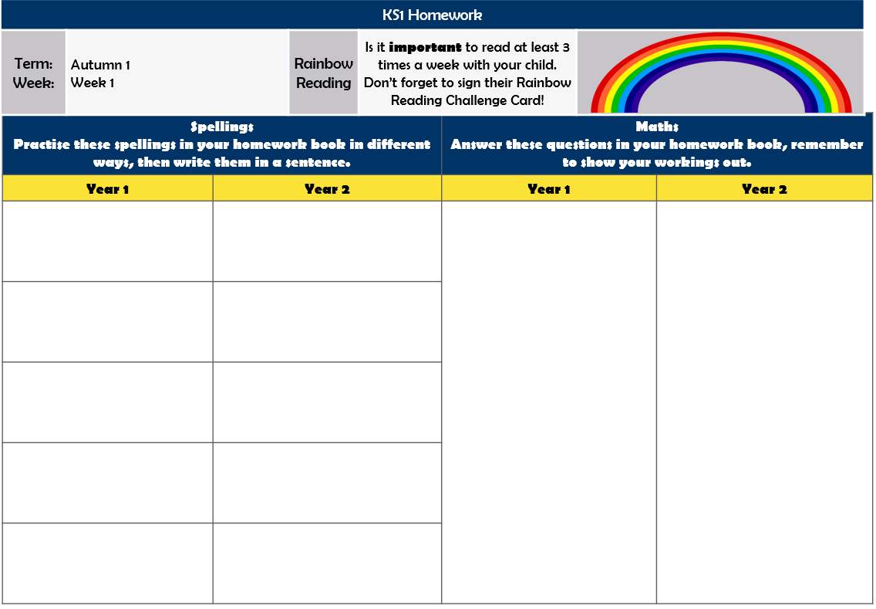
Homework
Children will also receive weekly homework in their homework books. This will include weekly Year 1 and Year 2 spellings for your child to practise at home before being tested on a Friday and some Year 1 and 2 maths questions related to what they have been recently doing in class.
Homework will be given out and collected on FRIDAYS!
Notes:
KP

Slide 24
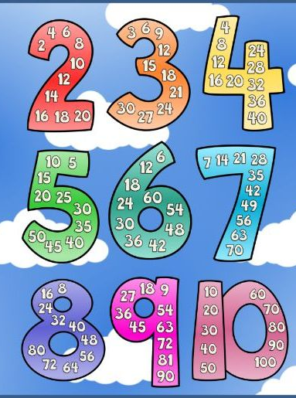
Times Tables
It is important that your child knows these by the end of the year.
Please practise them at home.
Year 2
Number Bonds to 10
Number Bonds to 20
Number Bonds to 100
Counting in 2s
Counting in 5s
Counting in 10s
2 x Tables
5 x Tables
10 x Tables
3 x Tables
Year 1
Recognise numbers and count to 5
Recognise numbers and count to 10
Recognise numbers and count to 20
Recognise numbers and count to 100
Number Bonds to 5
Number Bonds to 10
Number Bonds to 20
Counting in 2s
Counting in 5s
Counting in 10s
Each child will be provided with a login for Timestable Rockstars/ Numbots that they can use at home to practise as they wish!
We will be launching this on TTRS Day on ... by dressing up as Rockstars and Robots!
Notes:
KP

Slide 25
Assessment
Children will be assessed throughout the year by their class teachers in a variety of ways. This information will be used to plan next steps and future learning.
We will share the outcomes of these assessments throughout the year via Parent’s Evenings, End of Year Reports and Daily Conversations so we can work as a TEAM to support your child’s learning!
KS1 Formal Assessments
Year 1 will take part in Phonics Screening in June 2023
Year 2 children who did not take/pass Phonics Screening in Year 1 will retake in June 2023
Notes:
CP

Slide 26
PE
Children will have two PE sessions a week- one with a PE specialist and one with their class teacher. They are required to come to school in their PE kits on the day of their PE lessons.
As well as specific PE lessons each week KS1 children will be exercising every day in order to develop their fitness and gross motor skills through activities such as- daily run, yoga and dancing.
PE KIT
Black/Navy Shorts or Jogging Bottoms
White T-shirt
Black plimsolls or trainers
Badgers | Foxes | Hares | Hedgehogs | Owls | Rabbits | Squirrels
Tuesday Wednesday | Tuesday Wednesday | Tuesday Wednesday | Monday Wednesday | Monday Wednesday | Monday Wednesday | Monday Wednesday
Notes:
LF

Slide 27
Uniform

Slide 28
Things to remember:
Water Bottle
Book Bag with Reading Card, Reading Books and Homework Book (Friday ONLY)
Coat (for bad weather)
Hat (for good weather)
Wear PE kit on PE days
LABEL EVERYTHING!!!!
Notes:
CP

Slide 29
Thank you!
If you have any questions please catch any of us!
Now let’s go see KS1!
Notes:
CP

