Slide 1

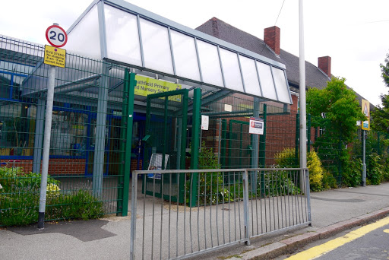
Welcome Meeting
Year 5 & 6 (Scotland Road)
2023 - 2024

Slide 2
Year 5 & 6 Team
Your first point of contact should be the class teacher:
 | Monday | Tuesday | Wednesday | Thursday | Friday
Tigers | Miss N’Jie | Miss N’Jie | Miss N’Jie | Miss Martindale | Miss N’Jie
Jaguars | Miss Johnson | Miss Johnson | Miss Johnson | Miss Johnson | Miss Johnson
Lions | Mrs Leighton | Mrs Leighton | Miss Shaw/Mrs Leighton | Miss Shaw | Miss Shaw
The easiest way to do this is to speak to them face-to-face at the end of the day, or send an email to the class email address.
Tigers | tigers@heathfield.nottingham.sch.uk
Jaguars | jaguars@heathfield.nottingham.sch.uk
Lions | lions@heathfield.nottingham.sch.uk

Slide 3
Year 5 & 6 Team
If you think your issue needs to go beyond the class teacher, I am
your initial point of contact as the UKS2 phase leader.
I can be contacted on any day at this email:
I will nearly always be available to speak to in person at Scotland Road on Wednesdays, Thursdays and Fridays.
On Tuesdays, I am mostly based at Kersall Drive, but can be contacted by members of staff to then either call you, or come over to see you.
On Mondays (or if you feel your issue needs to be dealt with beyond myself), the point of contact is Mr Padley (one of our deputy heads).
Please also make sure your contact details are up to date with the office so we can contact you!
Year 5 & 6 Phase email | Y5and6@heathfield.Nottingham.sch.uk

Slide 4
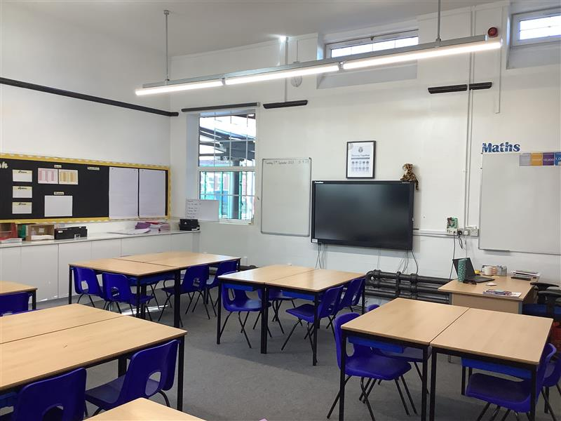
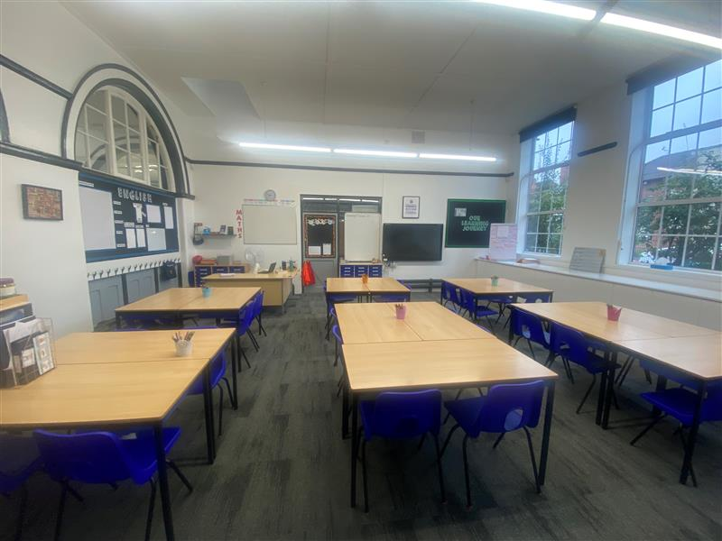
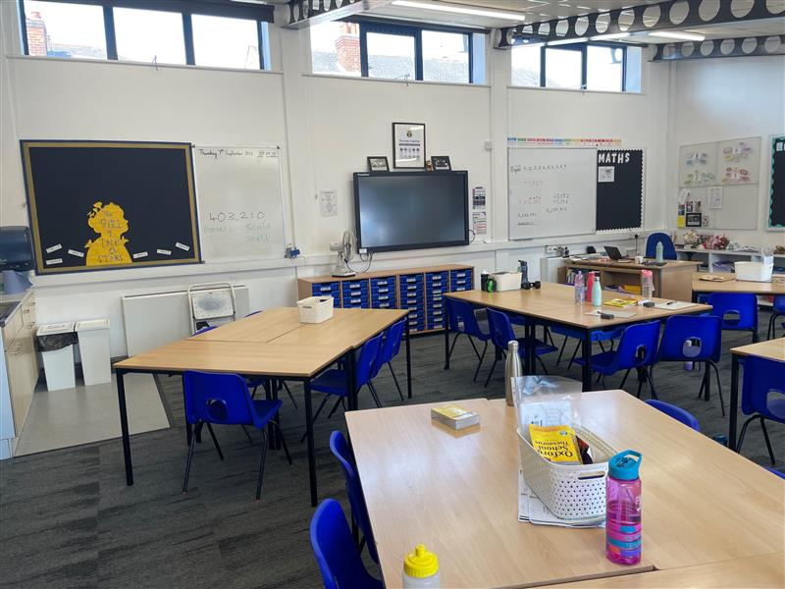
Classrooms
You can visit your child’s classroom, and have the opportunity speak to their class teacher at the end of this meeting.
Lions
Jaguars
Tigers

Slide 5
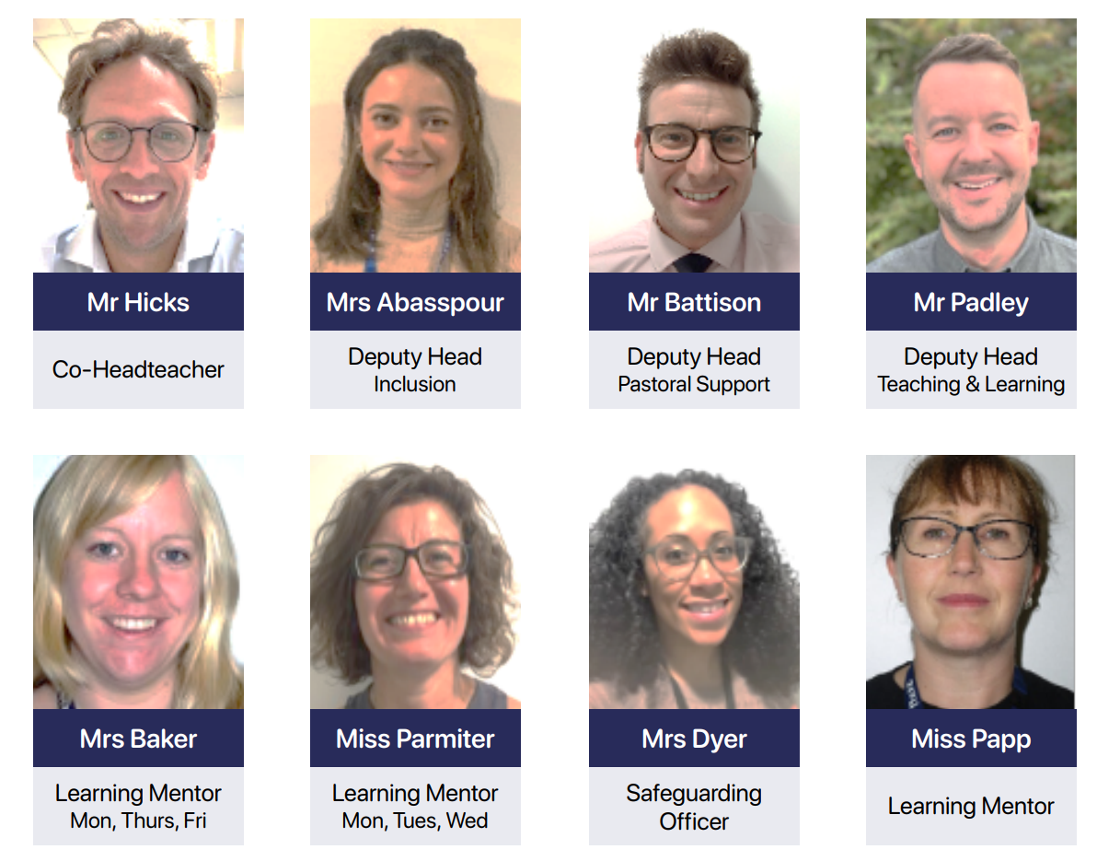
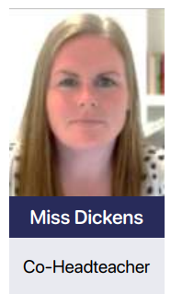
Safeguarding Team

Slide 6
Topics
Storms & Shipwrecks
Space
WWII
Autumn 1
Autumn 2
Spring 1
Ancient
Greece
Japan and China
Class choice book week
Spring 2
Summer 1
Summer 2

Slide 7
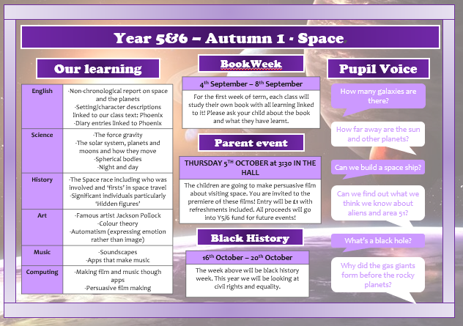
Topic Overview

Slide 8
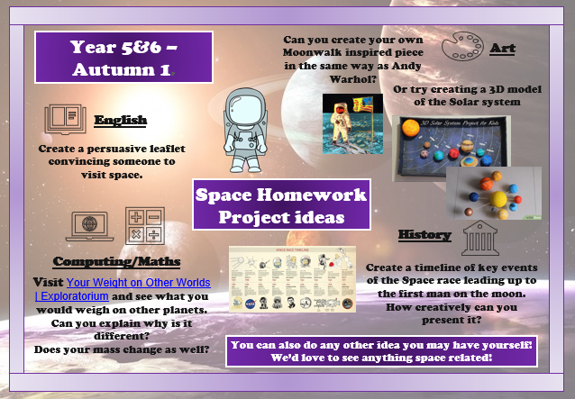
Topic Homework Menu

Slide 9
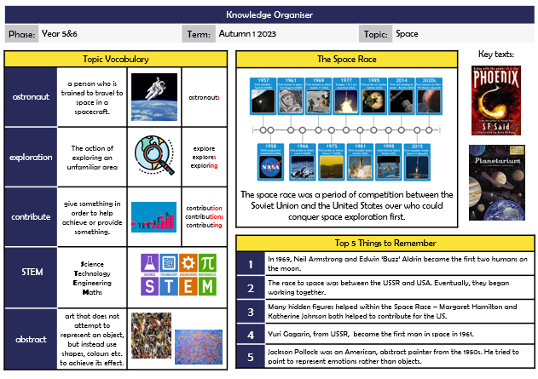
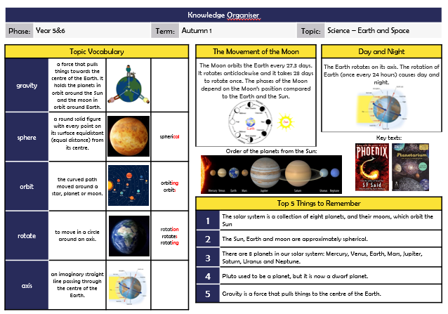
Topic Knowledge Organiser

Slide 10
Timetable
8:40 | Morning task
8:50 | Reading
9:30 | Maths
10:30 | Break
10:45 | Grammar, punctuation or spelling
11:00 | English (Writing)
12:00 | Lunch
1:00 | Class Book
1:15 | Foundation or Science
2:15 | Foundation or Science
2:45 | Assembly
3:15 | Home
Obviously, subject to change!

Slide 11
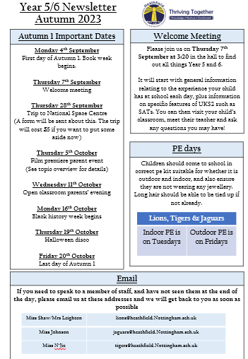
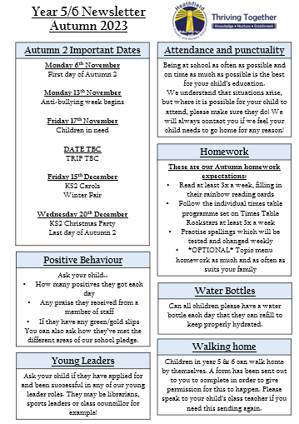
Newsletter

Slide 12
PE
 | Autumn 1 | Autumn 2 | Spring 1 | Spring 2 | Summer 1
Lions | Indoor: Tuesday Outdoor: Friday | Indoor: Tuesday Outdoor: Friday | Indoor: Tuesday Outdoor: Friday | Indoor: Tuesday Swimming: Friday | Indoor: Monday Outdoor: Friday
Jaguars | Indoor: Tuesday Outdoor: Friday | Indoor: Monday Outdoor: Friday | Indoor: Tuesday Swimming: Friday | Indoor: Tuesday Outdoor: Friday | Indoor: Tuesday Outdoor: Friday
Tigers | Indoor: Tuesday Outdoor: Friday | Indoor: Monday Outdoor: Friday | Indoor: Tuesday Outdoor: Friday | Indoor: Tuesday Outdoor: Friday | Indoor: Monday Swimming: Friday
Obviously, subject to change!
Summer 2 will vary for different year groups, classes and children, and we will let you know closer to the time.

Slide 13
Maths
Maths is the only subject where we teach Y5 and Y6 completely separately. This is because the curriculum is organised in this way, and it can be challenging to align objectives across both year groups.
YEAR 5 CURRICULUM
Miss N’Jie & Miss Johnson
YEAR 6 CURRICULUM
Miss Shaw / Mrs Leighton & Miss Malone

Slide 14
Expectations
Follow the pledge
Punctuality & Attendance
Commitment to home learning
Uniform - Regular & PE
Be their very best!

Slide 15

Expectations

Slide 16
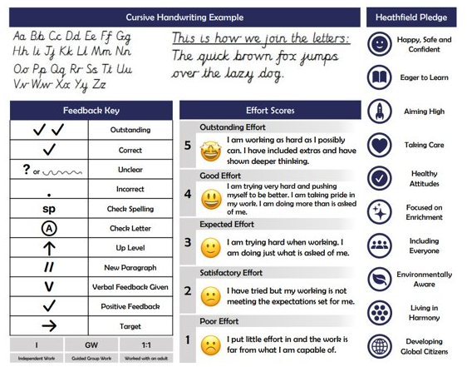
Expectations

Slide 17
Punctuality and Attendance
School now opens at 8:40. We will have a settle in activity for 10 minutes whilst the register takes place. We then start lessons at 8:50.
Arriving on time allows children to organise themselves for the day, and be sure of what is happening meaning they are more prepared, happy and confident. School finishes at 3:15.
As well as arriving on time, children should aim to be in as many days as possible! Every missed day means so many learning opportunities are missed and learning is sequenced so it can make subsequent lessons tricky due to gaps in knowledge or understanding.
Aim for on time, every day! ☺

Slide 18
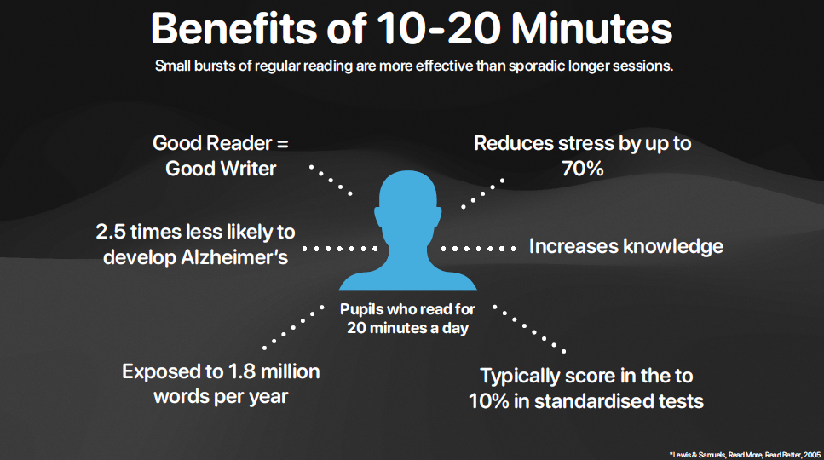

Homework: reading
Children should read at LEAST 3x a week. The 3 weekly reading sessions should be tracked on their rainbow reading cards.
Children are aiming to work through all of the colours to achieve gold at the end of the year. GOLD = CHOOSING A BRAND NEW BOOK TO KEEP!
Children will write a weekly journal entry in school about the reading they are doing at home
Every time the WHOLE class complete a colour, we received new books for our classroom too

Slide 19

Homework: Times tables
Children will work on a different times table weekly.
The beginning of the week will focus on the children being TAUGHT the tables
The middle of the week will focus on the children PRACTISING that table
At the end of the week, the children will be tested on that table
If generally the majority of children are secure with that table, they will move onto the next. If not, they will repeat that table that week with everyone trying to improve
A tracker will be kept updated with how everyone is doing, and a sticker reward chart will be used when children achieve a times table
Children can ensure their readiness by using TTRockstars and the paper sheets provided if they are struggling to access it
We will do in-class competitions as well as competitions between classes. Children can also work to be the FASTEST in school. (I’ve had children working at 0.5 of a second per question before!)

Slide 20

Homework: Spelling shed
Children will also have a login for spelling shed, and access to the games to practise their spelling
Each week, we will have a focus rule in school that we will work on together and look at words for
Children will be able to access that rule/words, or practise other ones they know they are unsure of
Reading is also massively BENFICIAL with helping spelling, so make sure they are meeting their rainbow reading targets first

Slide 21

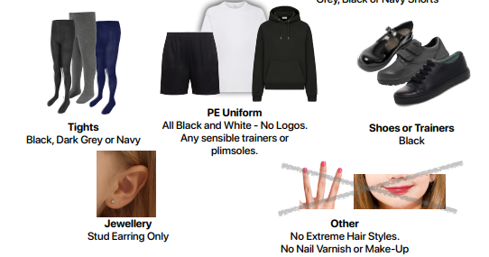
Uniform
(including PE)

Slide 22
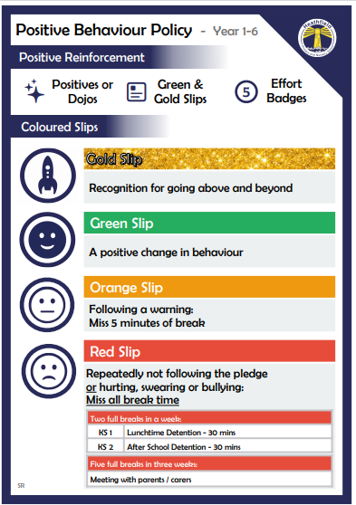

Slide 23
Be your best – earn positives!
We reward good behaviour with a ‘positive’ point
These will be added up each day/week in their class
The child with the most positives is the star of the week!
The star of the week with the most positives in the whole school wins a book!

Slide 24

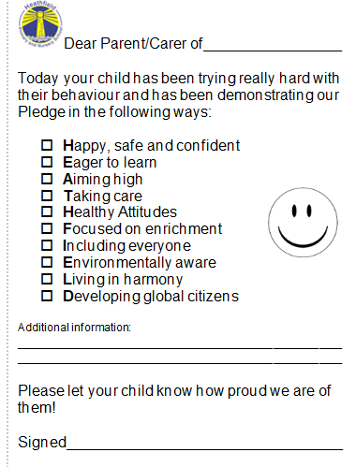
Slips (positive)
GOLD
GREEN

Slide 25
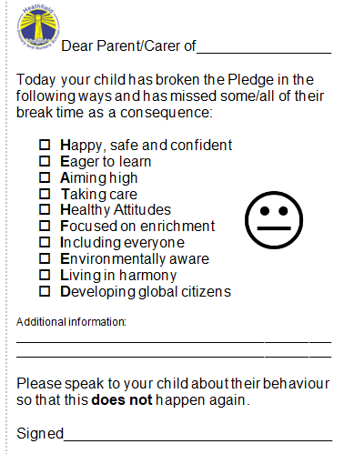

Slips (Negative)
ORANGE
RED

Slide 26


Phone/Online Safety
This half term, your children will have specific lessons focused on ONLINE SAFETY – a very important learning point in today’s society.
We will cover:
When we’re ‘online’, recognising how common It is
Private vs personal information
Secure Passwords
Appropriate photograph choice
Location settings
Accepting requests/meeting friends from online
Reliable/unreliable information
App age restrictions
Digital footprint
Cyber bullying
Digital wellbeing
If you wish to know more about any of this, or need any support with online safety please don’t hesitate to contact us. Knowledge is power, and we would like to prevent issues rather than cure.

Slide 27

STOP

Slide 28
Walking to/from school
With consent (through the form sent out by text or on the newsletter – ask us if you need it again please), children in UKS2 are allowed to walk home alone. They may bring a phone to school if doing so, but this must be given to the teacher for the day. (Children who are not walking home alone, do not require a phone in school).
Please ensure you discuss road safety and general safety with your children that walk home alone, or intend to do so. They must also remember they are still representing school whilst in their uniform, and their behaviour should reflect this. We want everyone to be happy, safe and confident!

Slide 29
Newsletter
The weekly newsletter sent out by text on a Friday is the main source of communication from school. PLEASE PLEASE PLEASE ensure you read this to keep up to date with everything that is going on school wide and in Y5/6 specifically. We may send out other information and links by text too.

Slide 30
After School Clubs
With no restrictions now in place, we will be able to offer much more in terms of after school clubs. Please keep your eye out on the newsletters, and/or for text links with more information about these once they are organised! It would be great to see everyone join at least one club throughout the year; we will ensure a range of different activities to cater to different interests.

Slide 31
Educational Trips
Our first trip to the National space centre is booked for Thursday 28th September. It will cost £5 - how to pay will be sent out shortly.

Slide 32
Residential Trips
LONDON
YEAR 6
We now do one residential visit in each phase (ours being UKS2). This is so more children can attend and it makes it a full year group event! Initial interest in the Y6 London residential went out last year, and deposit information and collection will be coming out shortly! Priority will be given to those who said yes to the initial interest, but there may be more spaces too.

Slide 33
Y5 Sleepover
Due to Y5 no longer having their own residential, we will be doing an outdoor sleepover (weather permitting – indoor otherwise) More information will be provided about this later in the year.

Slide 34
SATs
They are Key Stage 2 tests - not Year 6 tests.
Slow build up of knowledge and skills throughout the year.
Dedicated meeting will take place later in school year – do not
give them any thought now! If the children are doing what we ask of them in school, and at home, they will be golden!
13th – 16th May 2024

Slide 35
Secondary School Applications
All Y6 children should have received a letter from school regarding applying to their secondary school. The office has spares if you misplace this. You need to have applied by the 31st October. Most schools will be doing open evenings/days to have a look at the website of the schools you are interested in so you can go and have a look.
Please ask us if you need and advice about the application process, and be mindful of the importance of catchment as well as preference when making your choices

Slide 36

As part of our offer to support Year 6 through the curriculum, we offer 1:1 tutoring through our partners, Action Tutoring.
What do you need to know?
These 1:1 sessions are tailored to your child’s needs in either Maths or Reading
There are 20 sessions in total
Each session lasts 1 hour (3:30-4:30)
Face to face sessions with the same tutor every week
They are completely FREE to you – school and Action Tutoring cover all the costs
Refreshments will be provided
What do we expect?
Full participation in the sessions
Be committed to the entire 20 sessions – signing up means coming every week
Attend all sessions, missing 2 sessions will result in the session being offered to someone else – 100% attendance will earn you a Prize!
How do you sign up?
Take a consent letter, sign it and give to class teacher (you can do it now!) – This does not guarantee a place. We will inform when a place has been offered with a start date.

Slide 37
Support
We’re always here to help and support your children
We always try our best
Any questions, please come and ask. The end of the day is the best time to speak in person, or contact the teacher through the class email.

Slide 38
Any Questions
You can now visit your child’s classroom and ask their teacher or email teachers at the following addresses.
Tigers | tigers@heathfield.nottingham.sch.uk
Jaguars | jaguars@heathfield.nottingham.sch.uk
Lions | lions@heathfield.nottingham.sch.uk
Year 5 & 6 Phase email | Y5and6@heathfield.Nottingham.sch.uk

