Slide 1
London Trip 2023

Slide 2
Wednesday 28th June
Arrive at School at 8:15
We will walk to Highbury Vale tram stop and get on 9:10 tram.
Then we will get the 10:12 train.
Either bring own packed lunch or order one from school.
Stop half way for a break at a service station.

Slide 3
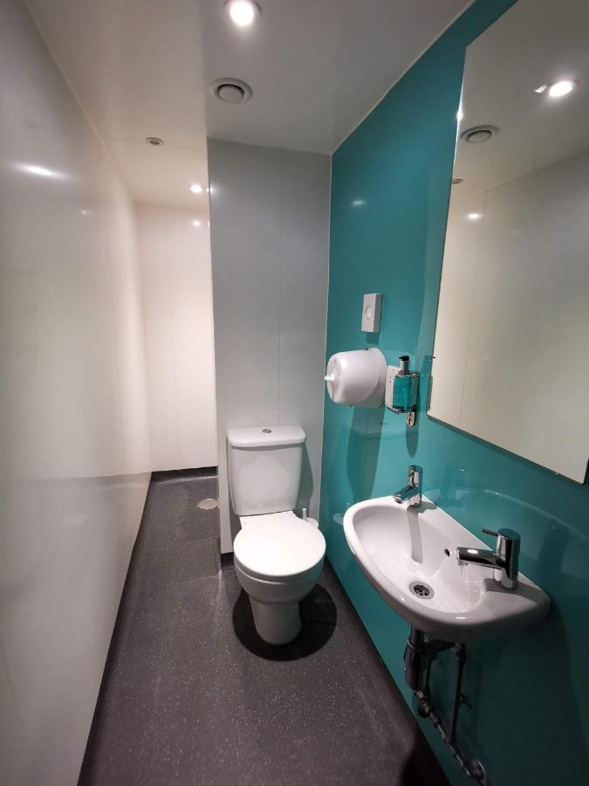
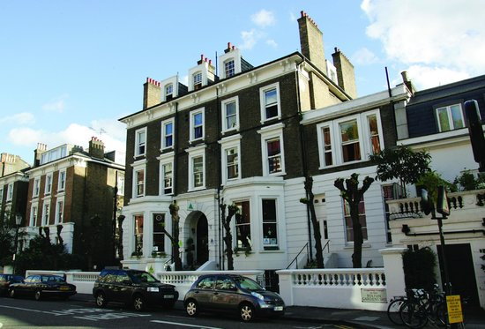
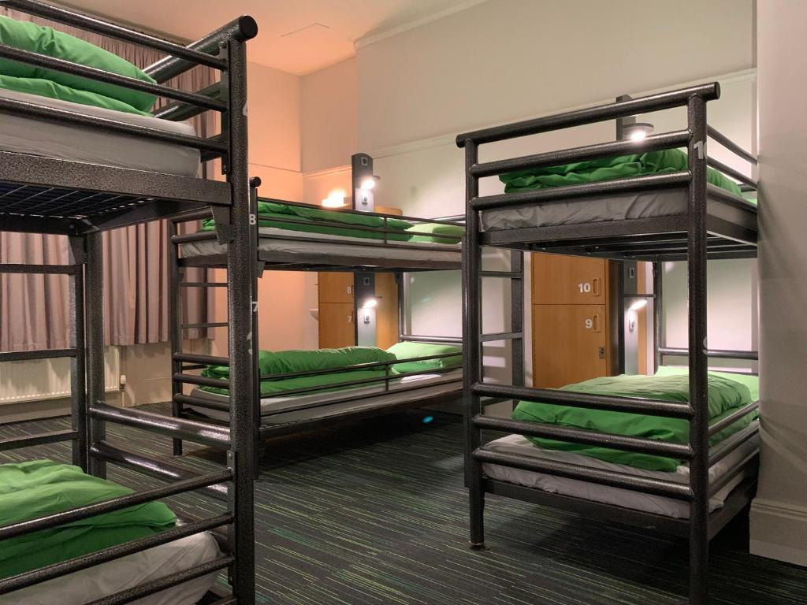
Earl’s Court Youth Hostel

Slide 4
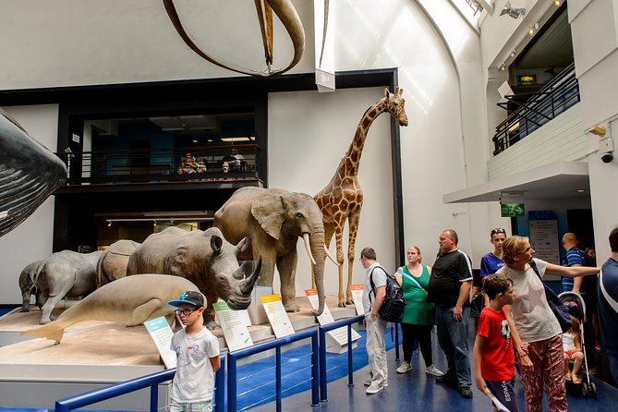
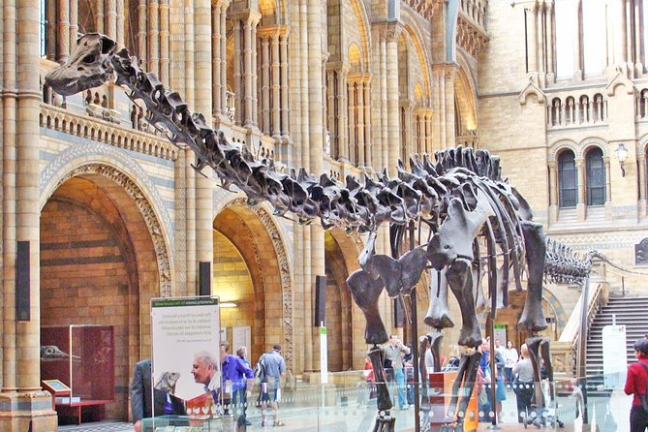
Wednesday afternoon
- Ten minute walk to the Natural History museum.
Return to Youth Hostel and get settled.
Dinner at the youth hostel.
Evening – play bingo and complete some challenges.

Slide 5
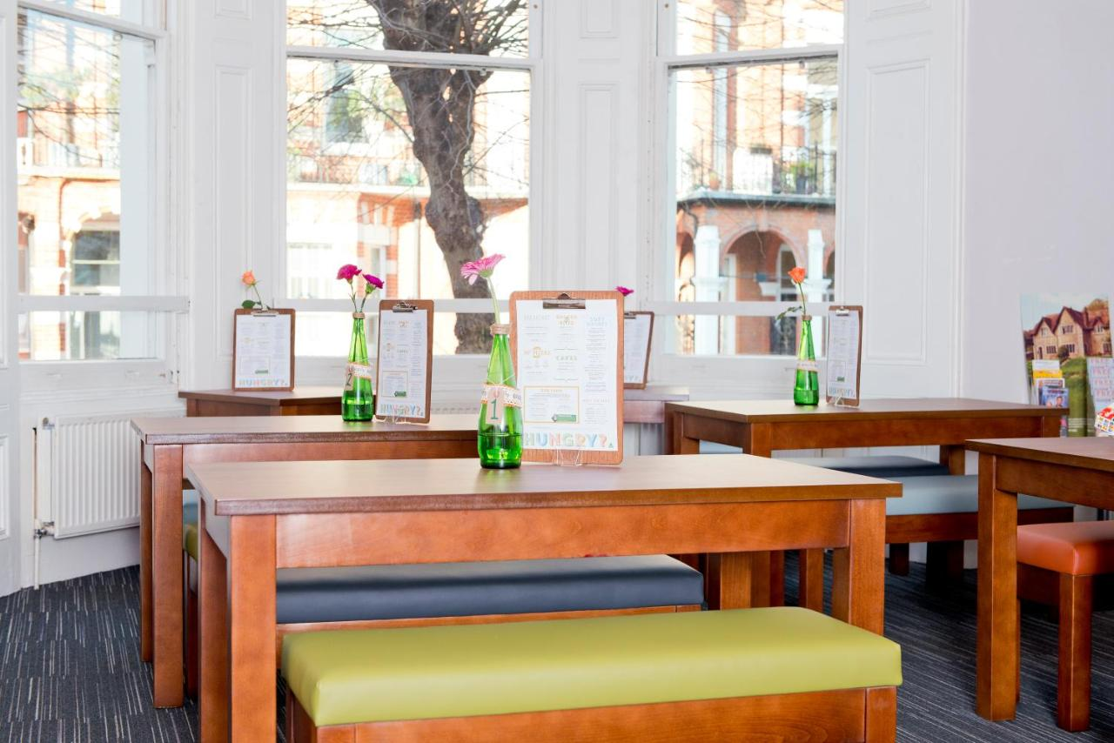
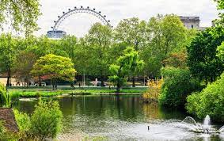
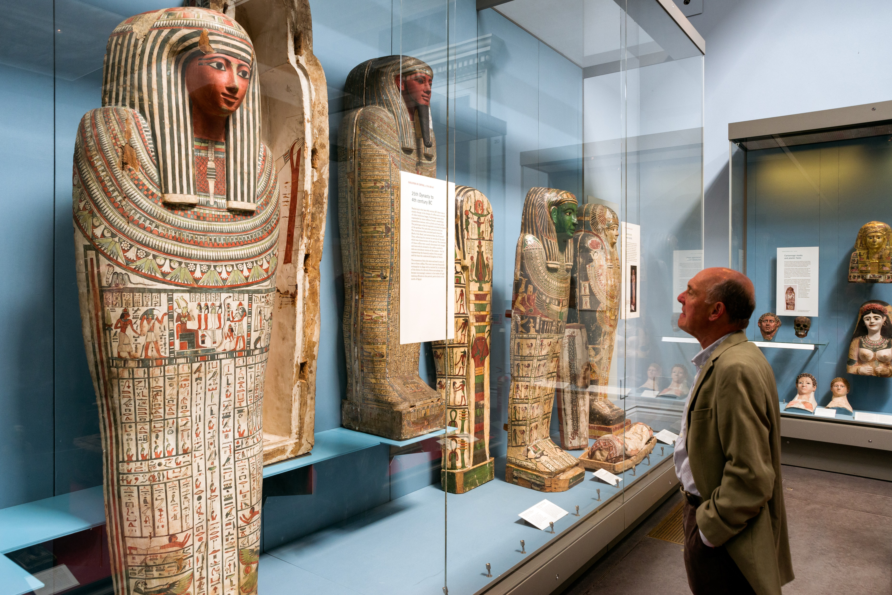
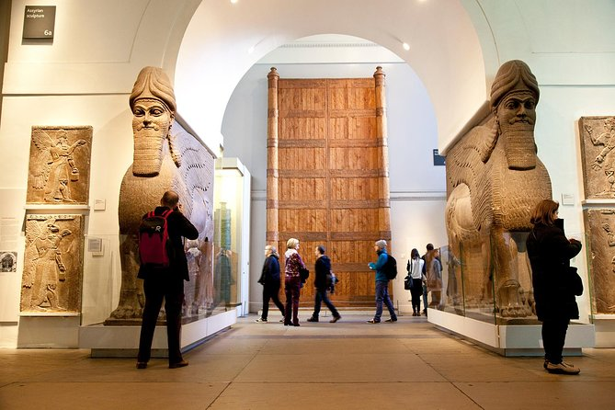
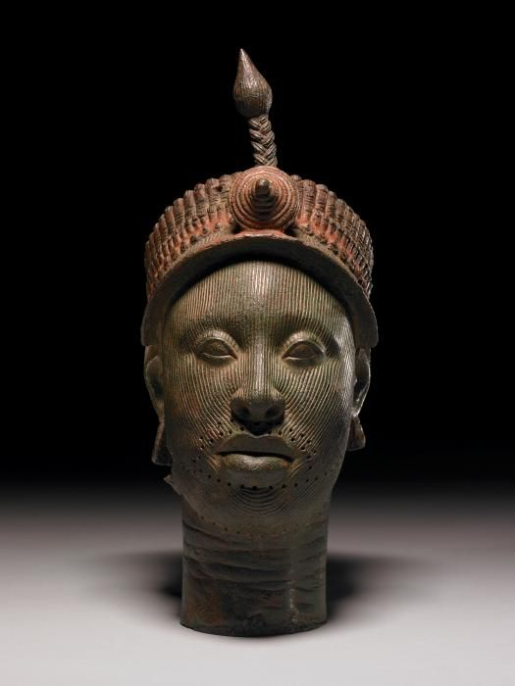
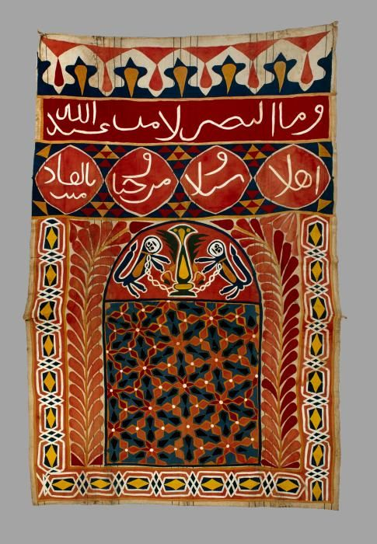
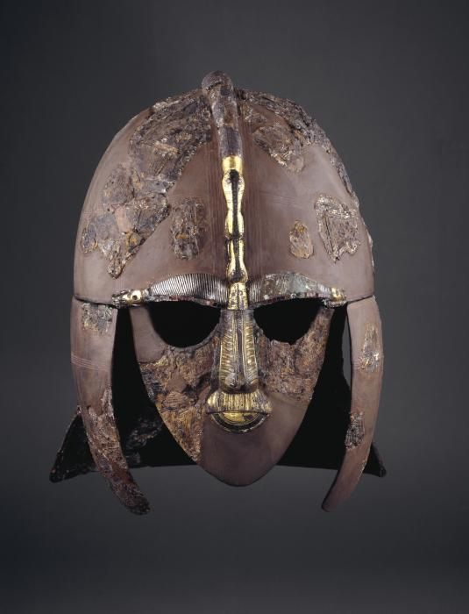
Thursday
Thursday
> Breakfast at the Youth Hostel – two sittings.
> 10:00 – Head to the British History Museum
> 12:30 – Leave Museum and have lunch in Russell Square.

Slide 6
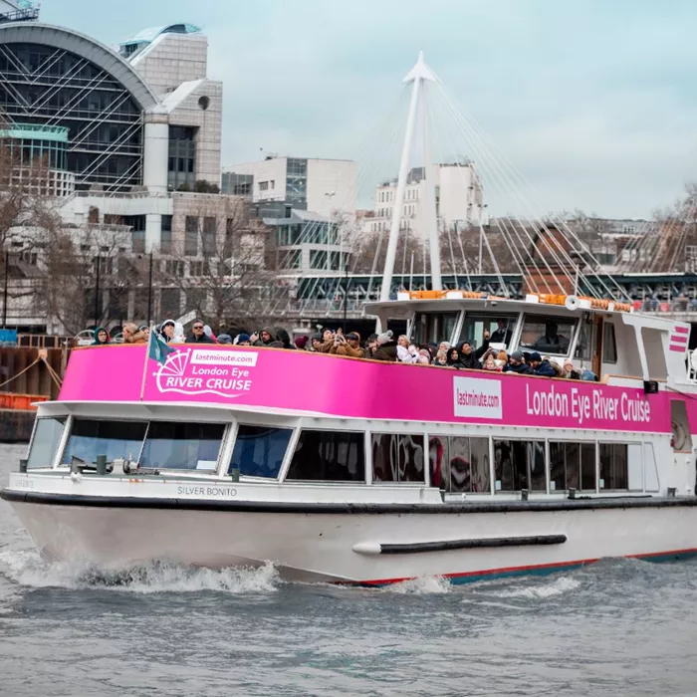
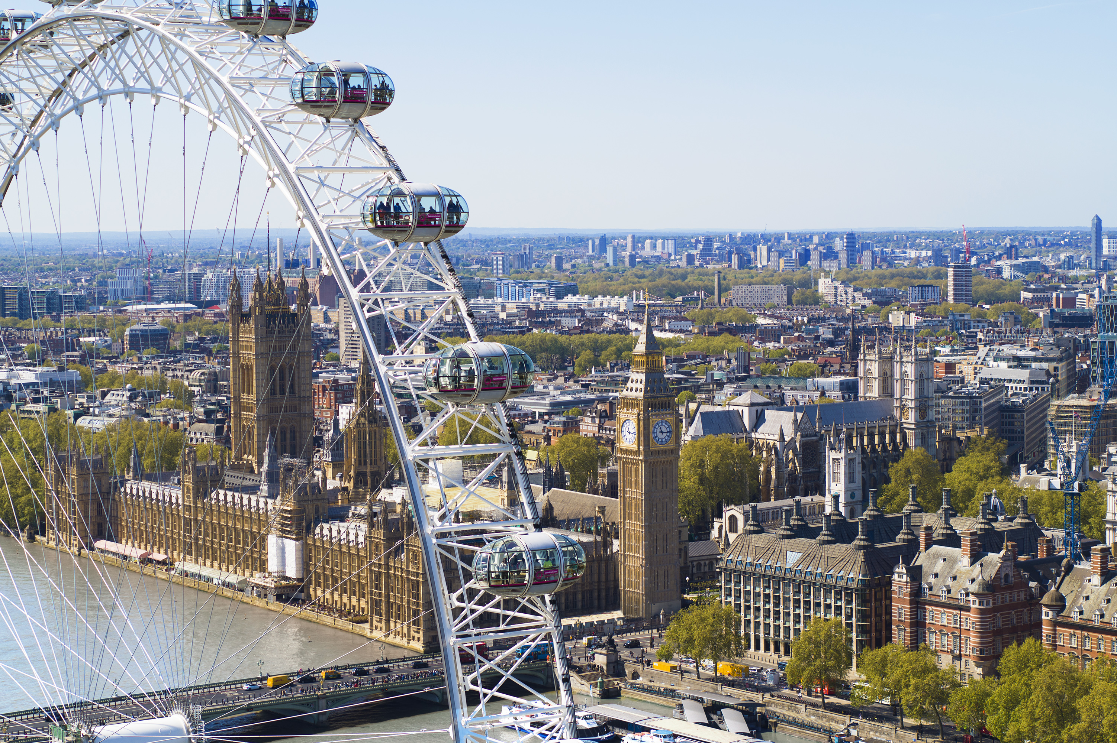
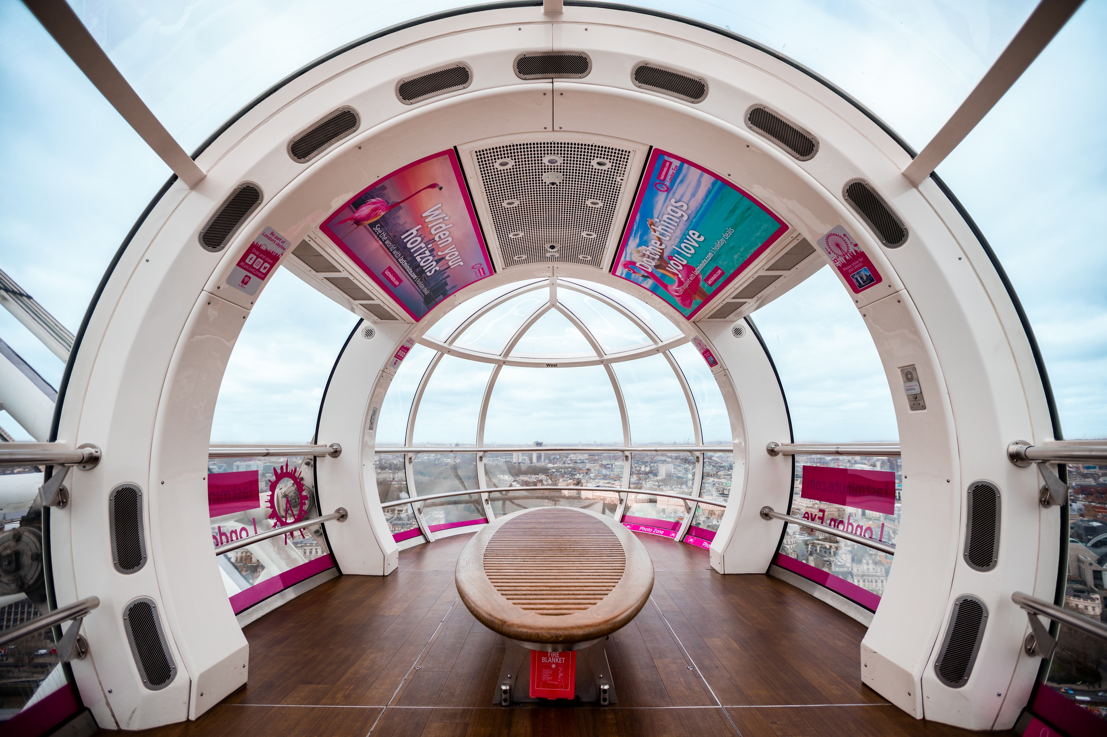
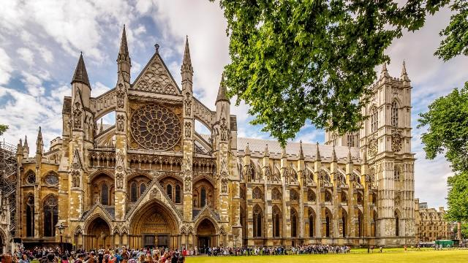
Thursday Afternoon:
Then travel on a river boat cruise.
Ride on the London Eye.
Big Ben, See Westminster
Games in St James’ Park
Dinner, Pack up things + Quiz Night

Slide 7
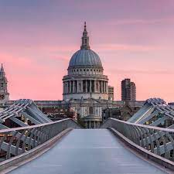
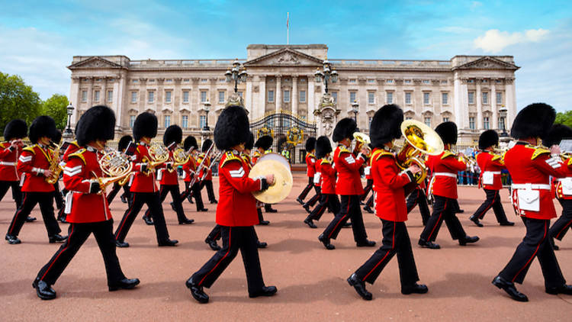
Friday Morning:
Breakfast
Go for a walking tour and see Westminster Abbey, Buckingham Palace, St Pauls’ Cathedral and Victoria Monument.
Go to St James’ Park for lunch (Mc Donalds).

Slide 8
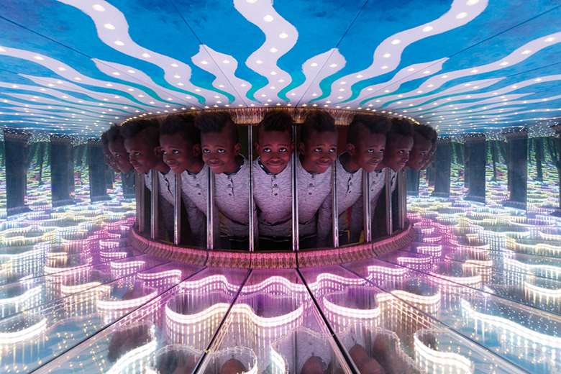
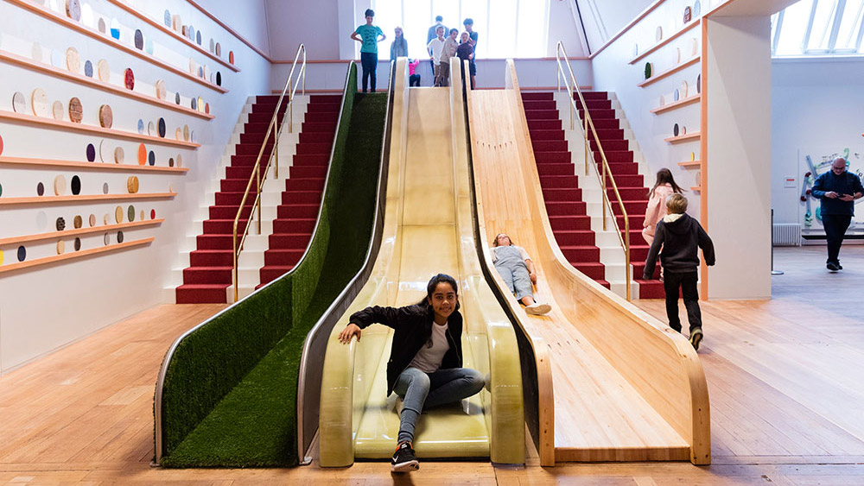
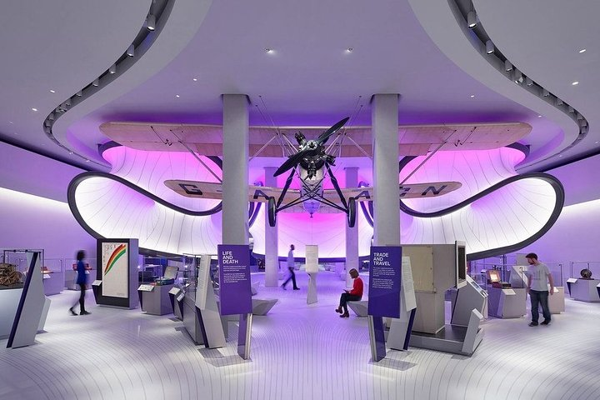
Friday Afternoon:
1pm visit the Science museum and enjoy the interactive Wonderlab exhibition.
Explore the other exhibits.
Return to the youth hostel to get our things
Board Train at 17:35 and eat our packed tea on the train.

Slide 9
What will your child need?
Pyjamas
Wash things and small towel.
Clothes and 1 sensible pair of shoes for walking.
Thin waterproof coat.
A back pack.
Lunch for Wednesday or order a school one.
Some spending money if they wish
Games they want to play (not electronic).
Medication will need to be handed in on the day. Please contact your teacher in advance so we are clear with how to dispense it.
ALL BELONGINGS WILL NEED TO FIT IN ONE BACK PACK / WHEELIE CASE THAT YOUR CHILD CAN TRANSPORT AROUND LONDON. WITH A BACKPACK FOR THE DAY TRIPS ALSO.

